Slide 1
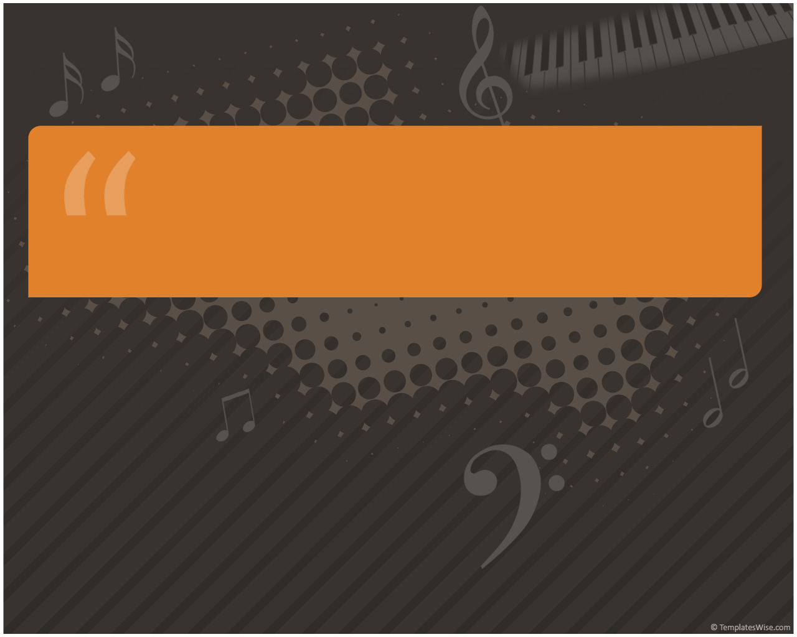
Neuromuscular Health and the Musician

Slide 2
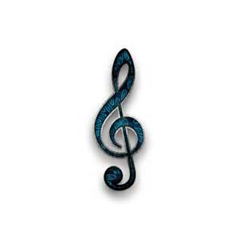
Overview of the Neuromuscular System
Nervous system and muscles are working together to allow movement
In order to move a part of your body, a message is sent to particular nerve cells which are called upper motor neurons.
These upper motor neurons go through the brain, and into the spinal cord, and connect with lower motor neurons.

Slide 3
Neuromuscular System
At the spinal cord, the lower motor neurons in the spinal cord send messages to nerves in the arms and legs, this results in muscle control
More Anatomy and Physiology

Slide 4
Musicians and Neuromuscular Health
Neuromusculoskeletal health is essential to your profession
Musicians are vulnerable to various neuromusculoskeletal disorders
The good news is many of these disorders are preventable

Slide 5
Statistics –Neuromuscular Injury
Caldron et al. surveyed 250 non–wind instrumentalists via a questionnaire and found that 59% reported some musculoskeletal problem
A study by Fry examined 485 professional symphony orchestra musicians and found that 312 (64%) suffered recurrent or persistent playing-related pain
Lederman, R. J. (2003), Neuromuscular and musculoskeletal problems in instrumental musicians. Muscle Nerve, 27: 549–561. doi: 10.1002/mus.10380

Slide 6
Studies and Statistics
A survey of 48 symphony orchestras carried out by the International Conference of Symphony and Opera Musicians showed that 58% of 2212 respondents reported a severe a musculoskeletal problem at some time during their career
Lederman, R. J. (2003), Neuromuscular and musculoskeletal problems in instrumental musicians. Muscle Nerve, 27: 549–561. doi: 10.1002/mus.10380

Slide 7
Interesting Facts
Women report more neuromuscular issues than men
Keyboard and string players seem to be more susceptible to neuromuscular issues
Music students are now beginning to report neuromuscular problems almost at the same rate as music professionals.

Slide 8
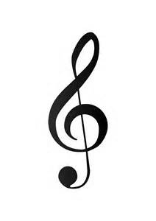
Neuromuscular Disorder Development
Some musculoskeletal disorders are related to behavior
Others result from trauma and injury
Genetics may play a role in certain individuals having a higher risk of developing neuromusculoskeletal disorders

Slide 9
Neuromuscular Disorders for Musicians
Repetitive Strain Injuries are most common in musicians
Some may call this Repetitive Stress Injury
Also known as Overuse syndrome
Overuse of hands to perform repetitive tasks
Carpal Tunnel is the most common RSI among musicians

Slide 10
Known Causes of RSI
Lack of general fitness
Chronic tense muscles
Undeveloped upper-arm, shoulder and back muscles
Repetitive tasks
Awkward positioning
Forceful exertion
Fatigue
Not warming up
Insufficient Rest Breaks
Pressing against hard surfaces

Slide 11
Signs and Symptoms of RSI
Weakness in hands or forearms
Tingling, burning, or numbness
Dropping items
Lack of strength
Lack of endurance
Pain

Slide 12
Examples of Other RSI Disorders
Carpal Tunnel Syndrome
Bursitis
Dupuytren's contracture
Rotator cuff syndrome
Tendinitis
Trigger Finger
Definitions of Disorders

Slide 13
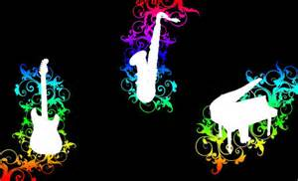
Who Gets What in the Music World?

Slide 14
String Instrumentalists
More prone to injuries on the back, shoulders and neck
Most often complain of muscle stiffness, pain, soreness, tension or numbness on the fingers, hand, wrist, neck, jaw, back and shoulders
Most common injury is repetitive strain

Slide 15
Wind Instrumentalists
More prone to ear, nose, throat, mouth, lips, neck, shoulder and arm injuries.
Right shoulder pain in flute players more common
Oboe players tend to have overuse problems in the webspace between the thumb and forefinger

Slide 16
Percussionists
Have more back, shoulder, neck, hand, wrist, fingers and arm pain and tension
The most common injuries of percussionists are tendinitis (inflammation of a tendon) and carpal tunnel syndrome
Carpal Tunnel

Slide 17
Brass
Have more back and neck pain
Potential for spinal problems due to body not in alignment while playing
Repetitive injuries prevalent
Carpal Tunnel

Slide 18
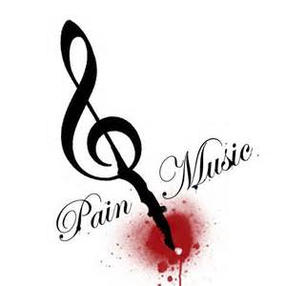
Seek Medical Care When…
You have actual pain or any other difficulty that impairs performance
Tell health care providers how playing music affects your body
they are not always aware of the physical strain placed upon musicians
Treatment will depend upon what condition you are diagnosed with

Slide 19
Let’s Do a Quick Review
This is a nicely done review, if you do not mind downloading Adobe 11.1 please watch
Review

Slide 20
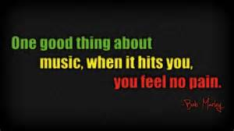
What Do You Need to Do To Take Care of Yourself?

Slide 21
Health Promotion and Prevention
Listen to your body
Do your warm up exercises
Stretch at intervals
Take frequent breaks to help with limiting repetition
Incorporate gradual increases in duration and intensity
If in pain do not play

Slide 22
Health Promotion and Prevention of Injury
Maintain personal health
Carry and set up equipment safely
Vary difficulty of music you are playing
Utilize good playing technique
Make sure the furniture you use is appropriate for the instrument you play

Slide 23
References
Lederman, R. J. (2003), Neuromuscular and musculoskeletal problems in instrumental musicians. Muscle Nerve, 27: 549–561. doi: 10.1002/mus.10380
Nordqvist, C. (2010). What Is Repetitive Strain Injury (RSI)? What Causes Repetitive Strain Injury? Medical News Today. Retrieved from http://www.medicalnewstoday.com/articles/176443.php
Robinson, D. (2002) Preventing musculoskeletal injury (MSI) for musicians and dancers : A resource guide. Retrieved fromhttp://www.co-bw.com/Health%20PDF/Preventing_injury_musicians_dnacers.pdf

Slide 24
References
Rowland, E. (2010). Carpal Tunnel Syndrome [Video file]. Retrieved from http://www.bing.com/videos/search?q=Severe+Carpal+Tunnel+Syndrome+Symptoms&Form=VQFRVP#view=detail&mid=01C6201606E24991157801C6201606E249911578
Simmons, J. (n.d). The neuromuscular junction: Function, structure & physiology. Education Portal. Retrieved from http://education-portal.com/academy/lesson/the-neuromuscular-junction-function-structure-physiology.html#lesson
Steven, L. Hayden, F. (2002). Maladies in musicians. Southern Medical Journal,(7) 95.

