Slide 1
Hearing Conversation for Musicians

Slide 2
What is Hearing Conservation?
Occupational Hearing Conservation
Non-occupational Hearing Conservation
Prevention of significant, permanent hearing loss
Resulting from on-the-job exposure to oto-traumatic agents (noise) in workers
Prevention of significant, permanent hearing loss
Resulting from off-the-job exposure to oto-traumatic agents in persons of all ages
Recreational activities: guns, motorsports, concerts, etc.

Slide 3
Hearing Conservation Amendment
OSHA – Occupational Safety & Health Administration
NIOSH – National Institute for Occupational Safety & Health
MSHA – Mine Safety & Health Administration
FRA –Federal Railroad Administration
Air Force & Army
15-20 million workers employed in unregulated non-manufacturing industries – ARE NOT REGULATED
Construction
Agriculture
Service
Musicians

Slide 4
Audiologist’s Role
Professionals that help people who are finding it difficult to hear or are hard of hearing by providing innovative solutions using both medical science and technology
Audiologists specialize in the following:
Normal and impaired hearing
Prevention of hearing loss
Identification of hearing and balance problems
Hearing Conservation and Protection
Rehabilitation
Dispensing of assistive technology systems
Notes:
with all we've learned about hearing conservation/hearing loss prevention over the years—is this problem rampant? Our world has gotten noisier, and there persists a lack of awareness of the cumulative effects of noise on hearing. Many think of NIHL as a consequence of working in industry; however, we're also seeing the effects of noise from recreational exposures—in children as well as adults. Audiologists have a responsibility to educate and motivate our patients, friends, and families about the hazards of noise and how to prevent damage due to excessive noise.
Audiologists perform any of the following functions:
prescribe and fit hearing aids
assist in cochlear implant programs
perform ear or hearing-related surgical monitoring
design and implement hearing conservation programs and newborn hearing screening programs
provide hearing rehabilitation training such as
auditory training
Speech reading
listening skills improvement

Slide 5
What does this have to do with me?
Music Induced Hearing Loss (MIHL):
A gradual hearing loss due to chronic noise exposure to loud music
Effects of music exposure are:
Gradual and may not be noticed for years
Not limited to hearing
Related to intensity (loudness) & duration (length) of exposure
Notes:
Student musicians are the gatekeepers to spreading the word of healthy hearing to their peers.
There also exists the thought that hearing loss only occurs during late adulthood, but this is not the case.
As musicians, you are exposed to loud music on a daily basis which puts you at a higher risk for experiencing auditory difficulties.
Music Induced Hearing Loss (MIHL): A gradual hearing loss due to chronic noise exposure to loud music
Effects of music exposure are:
Gradual and may not be noticed for years
Not limited to hearing
Related to intensity (loudness) & duration (length) of exposure

Slide 6
The pathway of sound
MIDDLE EAR
INNER EAR
OUTER EAR
Notes:
The Path of Sound:
• external canal
• vibrates eardrum
• vibration moves through ossicles – mallet (malleus), anvil (incus), stirrup (stapes)
• stapes vibrates oval window of cochlea • creates pressure wave in the fluid located inside
outer ear – protection,
– transmission of sound
middle ear – transformation into and transmission of mechanic
vibrations
inner ear – transformation of vibrations into neural impulses

Slide 7
What happens when there is a disruption of the Pathway?
Sensorineural Hearing Loss
Hearing loss caused by aging, illness, and excessive exposure to noise.
Conductive Hearing Loss
Hearing loss occurs when sound waves are prevented from reaching the inner ear.
Mixed Hearing Loss
Hearing loss caused by a combination of both sensorineural and conductive hearing losses.
Notes:
Sensorineural Hearing Loss
Hearing loss caused by aging, illness, and excessive exposure to noise.
Conductive Hearing Loss
Hearing loss occurs when sound waves are prevented from reaching the inner ear.
Mixed Hearing Loss
Hearing loss caused by a combination of both sensorineural and conductive hearing losses.

Slide 8
SENSORINEURAL Hearing Loss

Slide 9
INNER HAIR CELLS
Notes:
There are tiny hair cells of the inner ear (cochlea) or snail shaped spiral in the picture of the ear.
The inner ear is lined with hair cells that are too tiny to see without a microscope. There are 18,000 hair cells per ear. All 18,000 would fit onto the head of a pin.
On top of each hair cell is a delicate bundle of stereocilia - These hair bundles are pushed back and forth by sound waves.
The mechanical energy of the movement back and forth is converted to messages that are sent to the brain.
Our brain interprets those messages as sound.

Slide 10
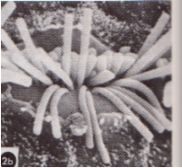
MIHL (Music-Induced Hearing Loss) Hearing loss as a result of prolonged or sudden exposure to loud Music
When our ears are exposed to levels of noise over 85 dB, the tiny hair cells in our cochlea can become disorganized and damaged from too much and too harsh of vibrations.
Once the hair cells break, they will NEVER grow back, this causes hearing loss.
Notes:
Music-induced hearing loss is caused by damage to the hair cells that are found in our inner ear.
Hair cells are small sensory cells that convert the sounds we hear into electrical signals that travel to the brain.
Once damaged our hair cells cannot grow back, causing permanent hearing loss.

Slide 12
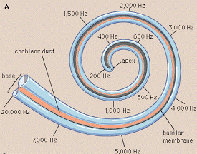
Why the Highs?

Slide 13
Associated Auditory Symptoms:
Hearing Loss
Tinnitus
Hyperacusis
Pitch Perception Difficulty
Diplacusis

Slide 14
Other Associated Symptoms
Frequent misunderstanding of what is said & often asks to repeat
Difficulty following verbal instructions and/or responds inconsistently
Turning up the volume of the television, radio, or stereo
Easily distracted
Short attention span or poor memory for sounds or words
Trouble identifying and/or localizing sounds
Hypersensitivity to loud sounds
Muffled hearing or ringing in the ears after you leave a noisy environment
This is temporary noise-induced hearing loss and is a sign that some damage has been caused to the hair cells in your ears
Trouble hearing certain consonants such as “s,” “sh,” and “t.”
Difficulty hearing when background noise is present, such as in a restaurant.
A constant or intermittent ringing, buzzing, or hissing in your ear.
This is called tinnitus.
Often a symptom accompanying hearing loss.

Slide 15
Noise is dangerous if…
You have to shout over background noise to be heard
The noise is painful to your ears
The noise makes your ears ring
You have decreased or “muffled” hearing for several hours after exposure
Notes:
You have to shout over background noise to be heard 
The noise is painful to your ears 
The noise makes your ears ring  
You have decreased or “muffled” hearing for several hours after exposure

Slide 16
___________________ 160 dB ___________________ 150 dB ____________________140dB
____________________130 dB
____________________120 dB
____________________110 dB
____________________100 dB
____________________90 dB
____________________ 80 dB
____________________70 dB
____________________ 60 dB
____________________ 50 dB
____________________ 40 dB
____________________ 30 dB
____________________ 20 dB
____________________ 10 dB ______________________0 dB
Intolerable
Pain
Very Noisy
Loud
Moderate
Faint
Very Faint
Live Rock Band
High Hat Symbol Strike
Full Symphony Orchestra
Fortissimo Singer @ 1 m
Loud Radio/Avg. Stereo Normal Piano Practice
Soft mp3 player in home
Background studio TV
Quiet Office
Rustle of Leaves
Notes:
This image displays an example of the Threshold of Hearing
This slide provides an example of the sound levels for different musical environments.
It is important to keep in mind just how loud some of these environments can get.

Slide 17
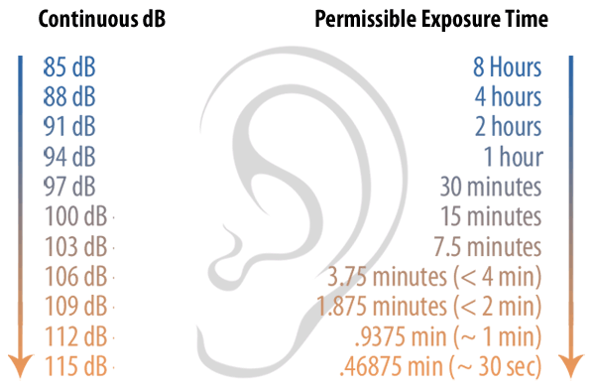
Effects related to Intensity & Duration:
Notes:
Sound levels measured in dB range from very faint sounds to very loud sounds.
The graph illustrates the relationship between intensity (measure of loudness in decibels) and duration (represented in hours, minutes, and seconds).
It displays the permissible exposure time as the intensity of the sound is increased.
The higher the intensity, the more damage that can be done to those hair cells, so a shorter amount of time is recommended.
The lower the intensity, the longer the permissible exposure time may be.

Slide 18
Factors to Consider:
(1) Instrument
(2) Piece of Music
(3)Environment
(4) Seating
Notes:
Before determining the Effects of High Music Levels, other factors should be included in the analysis:
The instrument that you play can put you at a higher risk.
For example, if you play percussion you are at the highest risk for excessive peak noise (or where the sound was the loudest during a span of time) at a level of 125 dB.
Trumpets, horns, and trombones are also at a higher risk for MIHL.
Also, other factors to consider may be the piece of music you play which can range in intensity
Consider the environment- are there several reflective services causing reverberation or echoing as well as increasing the overall noise level
Where you sit in regards to other instruments is also a very important factor.
For example, if you sit or stand in front of the trumpet section, then you are more likely to reach the maximum weekly exposure level only after 10-25 hours of playing.

Slide 19
Musical Instrument (at 3 meters) | Decibel Level (dB) | Decibel Sound Pressure Level (dB SPL/Peak Level)
Normal Piano practice Loud piano Keyboards (electric) | 60-90 70-105 60-110 | 105 110 118
Vocalist Chamber music (classical) Violin/viola (near left ear) | 70-85 70-92 85-105 | 94 99 116
Violin/viola Cello Acoustic Bass | 80-90 80-104 70-94 | 104 112 98
Clarinet Oboe Saxophone | 68-82 74-102 75-110 | 112 116 113
Flute Flute (near right ear) Piccolo | 102-118 92-104 90-106 | 126* 107 109
Piccolo (near right ear) French Horn Trombone | 102-118 92-104 90-106 | 113 106 125
Trumpet Tympani and Bass drum Percussion (high hat near left ear) | 88-108 74-94 68-94 | 113 106 125
Amplified guitar (on stage using ear-monitors) Amplified Guitar (on stage with wedge monitors) Symphonic Music | 100-106 105-112 86-102 | 118 124 120-137
Amplified rock music iPod in ear canal (Volume=6) iPod in ear canal (Full volume) | 102-108 94 105 | 140+ 110-130** 110-142**

Slide 20
Strategies for Prevention of MIHL:
Controlling the level of sound at it’s source & the propagation of sound toward the musician
Measure the noise level at the source using a SLM
Elevated speakers
Sound treated practice rooms
Use of risers
Alternate between pieces of high and low intensity
Play instruments with less force or practice mutes
Take frequent breaks from loud noises
Notes:
Strategies for the Prevention of MIHL should begin with controlling the level of noise at the source and controlling the propagation of sound toward the musician, whether it is the instrument itself, amplifiers, mp3 players, etc.
Measurements can be made to first determine the level of the noise. This can be accomplished by a Sound Level Meter (SLM) that measures and records the level of the noise over a certain amount of time.
Elevate speakers to provide more of a freq. response
Sound treat practice rooms with for example, acoustic panels or carpeting on the floors.
Utilizing risers for the Treble bass instruments
Alternate musical pieces to allow for recovery
Have high-powered instruments play with less force and utilize practice mutes or practice pads while rehearsing
Take frequent breaks from loud noise sources

Slide 21
Selecting HPDs:
The selection of an appropriate HPD must take into account at least three factors:
The individual's noise exposure
Any existing hearing loss
The need to communicate in the presence of excessive background noise
Notes:
HPDs can do a fine job provided they are properly selected, fitted, and monitored.
One size does not fit all, and there is no "best" protector.
The selection of an appropriate HPD must take into account at least three factors:
the individual's noise exposure, (2) any existing hearing loss, (3) and the need to communicate in the presence of excessive background

Slide 22
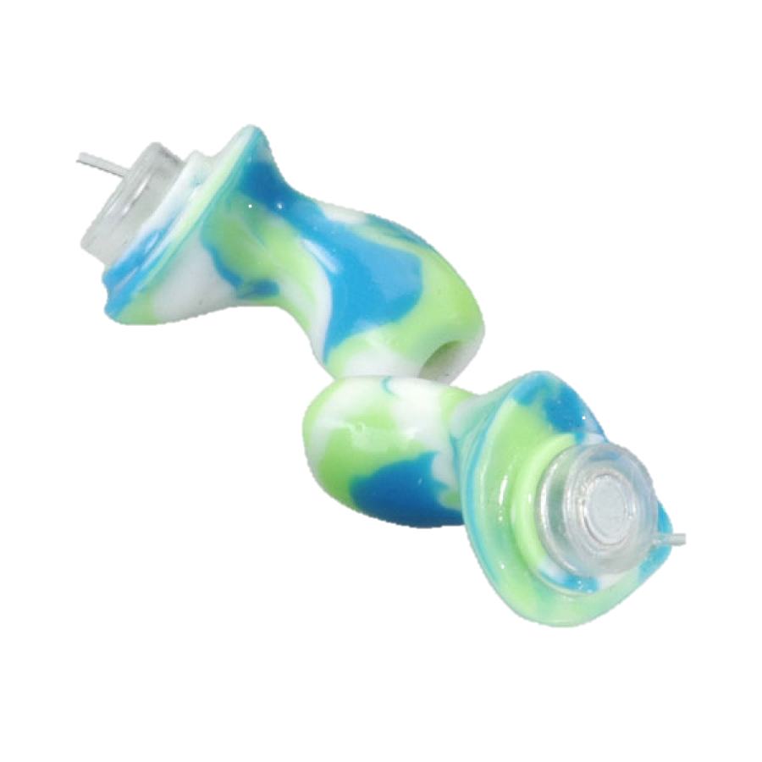
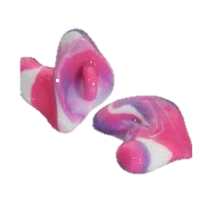
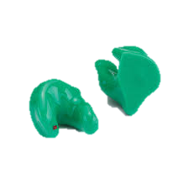
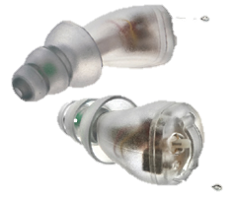
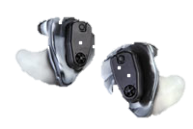
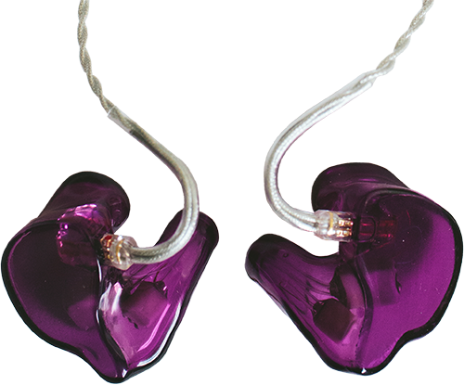
Custom Ear Plugs:
Passive:
No electronic component
Ability to customize filtering or boring for communication
Active:
Upgrade or replace the electronics for long-term hearing protection
Unlike traditional passive hearing protection, enhances low-level sounds instead of blocking them.
Musician’s Active ear plugs
In-ear monitors

Slide 23
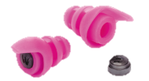
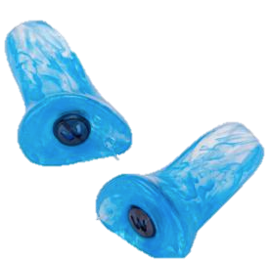
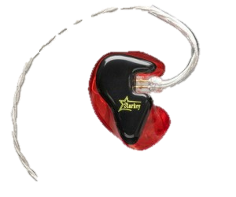
Hearing protection for Musicians
Flat-attenuation earplug
Low to moderate noise exposure of 90 dB
or less
Musician’s Earplugs
Replicate the natural resonance of the ear canal
Boosts high frequency sounds
3 attenuation filters (9, 15, 25 dB of attenuation)
In-the-ear Monitors
Allows for musician’s to hear of PA systems, crowds,
noise, & high-volumes on stage from the other band
members instruments and equipment
Regulate the sound reaching the Musician’s eardrum
Notes:
Regulate the sound reaching the Musician’s ear:
Flat attenuation earplug: good for low to moderate noise exposures of about 90 dB or less
Musician’s Earplug: Replicate the natural resonance of the ear canal (boosts high frequency sounds)
3 attenuation filters
IEMs: Allows for musician’s to hear of PA systems, crowds, noise, & high-volumes on stage from the other band members instruments and equipment
Wearing hearing protection during recreational use is highly advised as well. For example, when at concerts, hunting, or large sporting events.

Slide 24
Conclusions:
Hearing Tests Annually
Wear hearing protection
IEMs and attenuation plugs reduce the sound level at the ear
Consider room acoustics and your practice environment
Use dampers or practice mutes
Set volume limits on mp3 players
Become an advocate!
Notes:
Hearing Tests Annually
Wear hearing protection
IEMs and attenuation plugs reduce the sound level at the ear
Consider room acoustics and your practice environment
Use dampers or practice mutes
Set volume limits on mp3 players
Become an advocate!

