Slide 1
Basic Compliance & Ethics Training
For UWF Staff & Faculty

Slide 2
What Does Compliance Mean For You?
Knowing, RESPECTING, and following the rules.

Slide 3
Employee Responsibilities
Stay Informed
Raise Questions
Report Concerns
UWF Community Members are Prohibited From:
Knowingly violating applicable laws, regulations, and policies;
Retaliating against another community member for reporting a suspected violation or infraction

Slide 4
Need to Know: UWF Regulations

Slide 5
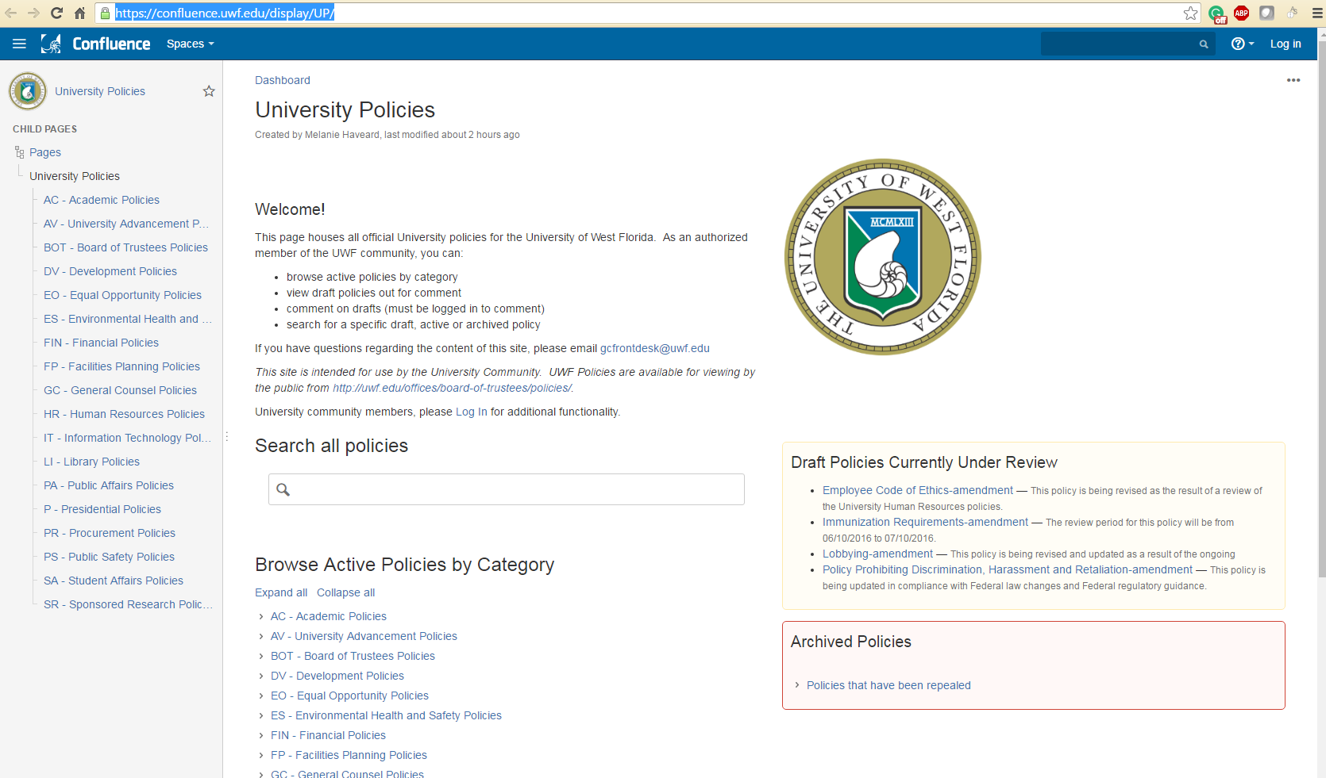
Need to Know: UWF Policies
https://confluence.uwf.edu/x/P4NFAg

Slide 6
Compliance vs Ethics
Compliance = Legal Responsibility
Ethics = Culture

Slide 7
Compliance is all about…
Conforming to all:
Laws
Policies
Obligations
Regulations
Procedures

Slide 8
Ethics is…
Virtues and Values
Right is Right
Even if no one is doing it
Wrong is Wrong
Even if everyone is doing it

Slide 9
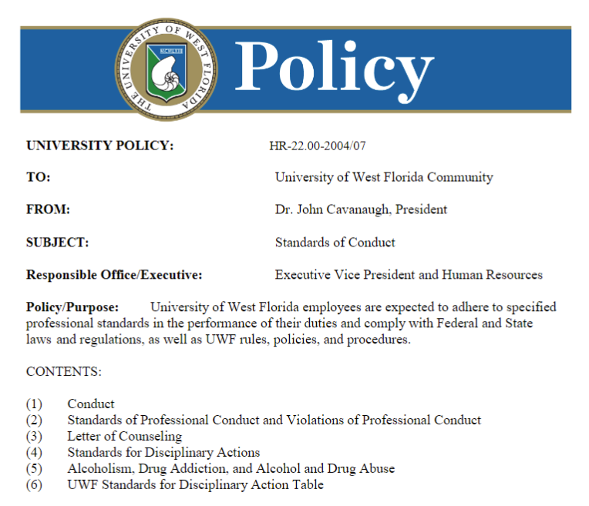
Code of Conduct & Standards of Conduct
Employee Code of Conduct
Standards of Conduct

Slide 10
Florida Code of Ethics (FCOE)
Conflicts of Interest
Gifts/Benefits
Misuse of Public Position or Non-Public Information
Business, Contractual, & Employment Relationships
Nepotism
FCOE for Public Officers and Employees prohibits or restricts us from private gain
Establishes standards of conduct
Applicable to all state employees

Slide 11
FCOE: Penalties for Noncompliance
Penalties can include:
Reprimand, suspension, demotion, salary reduction, dismissal and restitution.
Forfeiture of 1/3 salary per month for up to 12 months.
Civil penalty of up to $10,000

Slide 12
Accepting Gifts
Do not accept anything of value based on the understanding that your actions or judgement will be influenced thereby.

Slide 13
What is “Anything of Value”?
Examples:
Gifts
Loans
Rewards
Promises of future employment
Favors or services

Slide 14
Solicited Gifts
Do not solicit any gift from a Vendor or Lobbyist for the personal benefit of yourself or any other person

Slide 15
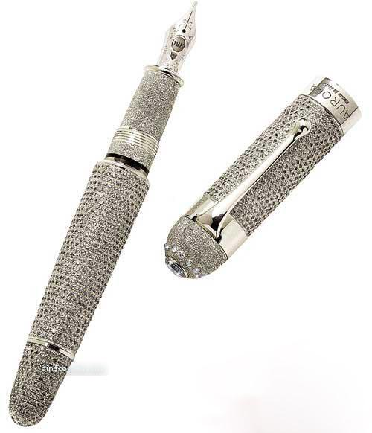
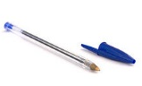
Gifts of Influence
Caveat… “when you know, or should know, it was given to influence your official actions”
Not accepting “anything of value”…
The larger the gift, the more you should know
Diamante by Aurora: $1.28 Million
Pack of 10 Bic Pens: $1.39

Slide 16
Greater than $100
Do not accept any gift from a Lobbyist or Vendor that you know, or should reasonably believe has a greater value than $100, if you are a procurement employee.

Slide 17
What is a Procurement Employee?
Any employee participating in procurement through:
Decision, approval, disapproval or recommendation
Preparing purchase requests
Influencing specifications or standards
Investigations or auditing
Any other advisory capacity

Slide 18
Misuse of Non-Public Information
APPLIES TO ALL CURRENT & FORMER EMPLOYEES!!!
Do not disclose or use non-public information for personal gain or benefit of yourself or any other person or business entity.
Such as; educational records, medical records, PII and PHI

Slide 19
Conflicting Relationships
This includes any business, employment or contractual relationship

Slide 20
Nepotism
Nepotism… It’s All Relative

Slide 21
Nepotism Guidelines
Do not employ related persons in a single organizational unit or work-related unit unless first approved.
Approval can only happen when one related person can not affect the other’s:
Appointment
Retention
Work Assignments
Evaluation
Promotion
Demotion
Salary

Slide 22
What is a “Related Person”
Husband or wife
Parent or child
Brother or sister
Grandparent
Grandchild
Aunt or uncle
First cousin, niece, or nephew
Spouse of a child, brother, sister or parent
Parent, child, brother or sister of spouse
Fiancé or fiancée
Persons intending to marry or form a household
Same legal residence

Slide 23
Outside Activity
Any activity not part of the your UWF system duties and for which the UWF system does not compensate you.

Slide 24
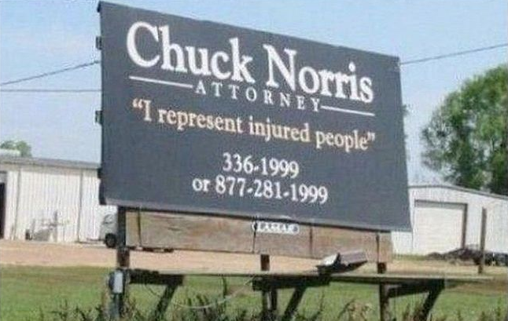
Conflict of Interest
Conflict of Interest; noun: a situation in which a person is in a position to derive personal benefit from actions or decisions made in their official capacity.

Slide 25
Disclosure of Outside Activity
Types of Outside Activities:
Use of UWF system facilities, equipment, or services
Waiver or assignment of rights to inventions or works
Candidacy for, or holding public office
Compensated activity
Potential Conflict of Interest (COI)

Slide 26
Annual Florida Code of Ethics Disclosures
All faculty members
All administration employees
Staff employees with a P-card
Temporary employees with a P-card
Required to file:

Slide 27
Fraud Prevention
“The intentional use of deceit, a trick or some dishonest means to deprive another of his/her/its money, property or a legal right.”

Slide 28
Recognizing Fraud
Examples of Fraud:
Forging or altering documents
Misrepresenting information
Misappropriating funds, supplies, or other assets
Theft, disappearance, or unauthorized destruction
Improprieties in handling/reporting of money transactions
Authorizing/receiving payment for goods not received or services not performed

Slide 29
UWF Integrity Helpline
UWF utilizes a third party hosted hotline
Safe, secure & anonymous reporting
Available 24/7 to all employees
Report by Phone or Online: 1.844.858.1413 or uwf.ethicspoint.com
CTRL your Integrity

Slide 30
Retaliation: Making it Personal
There is no tolerance for retaliation, retribution or reprisals against an employee or student who, in good faith, files a complaint, grievance, or report of violations of the law, rule, regulation, policy, or other misconduct.
Source: Equal Employment Opportunity Commission (https://www.eeoc.gov/laws/types/facts-retal.cfm)

Slide 31
Examples of Retaliation
Reprimand or give a performance evaluation that’s lower than it should be
Transfer the employee to a less desirable position
Engage in verbal or physical abuse
Threaten to make, or actually make reports to authorities
Increase scrutiny
Spread false rumors
Make the person's work more difficult
Examples of Retaliation:

Slide 32
Florida’s Sunshine Law
As a UWF employee you are subject to comply with public record laws:
F.S. Chapter 286, the “Open Meetings Law;”
Protects the public from “closed door” decision making and provides a right of access to public meetings
F.S. Chapter 119, the “Public Records Law”
Creates a right of access to records made or received in connection with official business of a public body

Slide 33
What is Public Record?
"Every thought, as well as every affirmative act, of a public official as it relates to and is within the scope of his official duties, is a matter of public concern; and it is the entire decision-making process that the legislature intended to affect by the enactment of the statute before us.“
- Florida Code of Ethics, Sunshine Law and Public Records Act

Slide 34
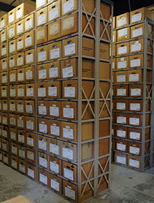
What’s Considered a Public Record?
Written documents (e.g., notes taken during a staff meeting)
Other material regardless of physical form or means of transmission made or received pursuant to law in connection with transaction of official business by the agency
Examples of Public Records:
Email (even if sent from personal computer or phone as long as it relates to university business)
Sound recordings
Photographs
PowerPoint presentations
Text messages (regardless of where the text originated, as long as it relates to university business)
UWF Records Center (Bldg. 48)

Slide 35
Responding to Public Records Requests
All employees must accept public records requests when asked
Inform them that you are forwarding the request to General Counsel
Forward request immediately to General Counsel
General Counsel will work with the appropriate department to fulfill the request
For record retention inquiries, contact Gus Harris @ x2693 or gharris@uwf.edu
What To Do:

Slide 36
IT Security and Privacy @ UWF
ITS Guidelines & Best Practices
Carefully read, understand and abide by the UWF Computing Resources Usage Agreement
UWF assigned login credentials are confidential
Do not violate copyright agreements or state law
Use of UWF computing resources is not completely private

Slide 37
Never Hesitate to Ask for Help
Compliance and Ethics x6070
General Counsel x3419
Human Resources x2156
UWF Police Dept. x2022
Title IX x2175
Integrity Helpline 844/ 858-1413
Internal Auditing x2636
If you only take away one thing… remember that we are here to help

Slide 38
Any Questions/ Comments?
Matt Packard | mpackard@uwf.edu | x6070

