Slide 1
Creating Memos Mini-Lesson #70a
Created by Hunter Brown
Summer 2013

Slide 2
Creating Memos
“Memos are brief printed documents traditionally used for the routine, day-to-day exchange of information within an organization.”

Slide 3
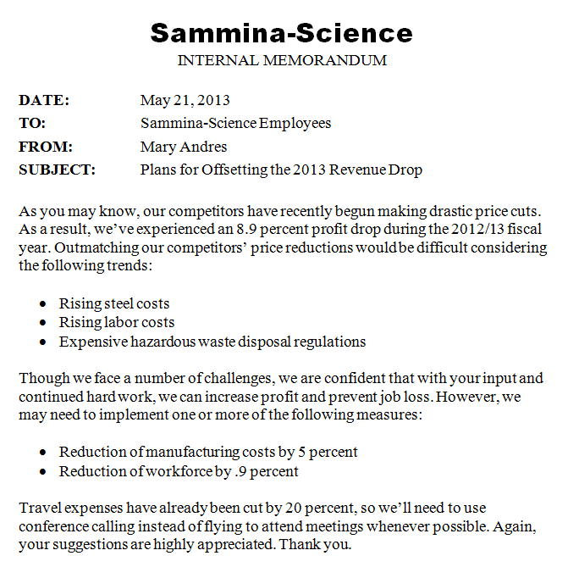
Begins with title indicating that this is a memo
This is a sample memo.
Uses four standard headings
Body does not begin with a salutation
Uses bullet points to improve readability
Does not end with a complimentary close or a signature block

Slide 4
Title
Many companies have memo stationery with the company name or logo at the top. Stationery is optional, however.
Memos typically begin with titles such as MEMO, MEMORANDUM, INTERNAL MEMORANDUM, or INTEROFFICE CORRESPONDENCE.
Usually, the title is written in all caps and is centered or left-aligned.

Slide 5
Heading
The four standard headings for memos are TO:, FROM:, DATE:, and SUBJECT: (or Re:, short for Regarding).
These headings can be arranged in almost any order, but the order shown above is the most common.
The information following these headings should be aligned (see sample memo).
The subject line should be short and informative. It may overflow to a second line if necessary.

Slide 6
Body
The body should begin two or three lines below the heading.
Salutations, such as “Dear Employees” or “Hello, Everyone” are unnecessary.
The body is usually single-spaced with one blank line between each paragraph; however, very short memos may be double-spaced.
Indenting paragraphs is optional.
If a memo extends to a second page, head the second page as you did the first.

Slide 7
Other Information
No complimentary closing or signature block is necessary.
Courtesy titles, such as Dr. or Ms., need not be used in memos, unless you would use the courtesy title when speaking to the addressee face-to-face (e.g., Mr. President).
Use bulleted lists to improve readability and to draw readers’ attention to the key points of your memo.
Do not use slang or informal language. Strive for a tone that is professional, but not stuffy.
In many companies, it is standard practice to sign your initials next to the FROM line.

Slide 8
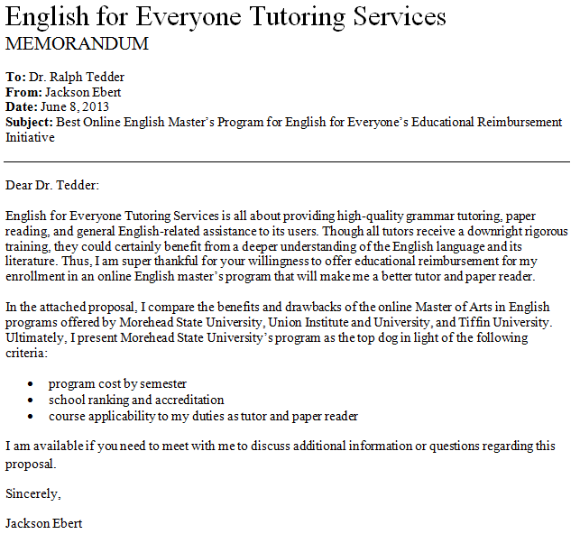
Using the rules on the previous slides, can you find the errors in this memo?

Slide 9
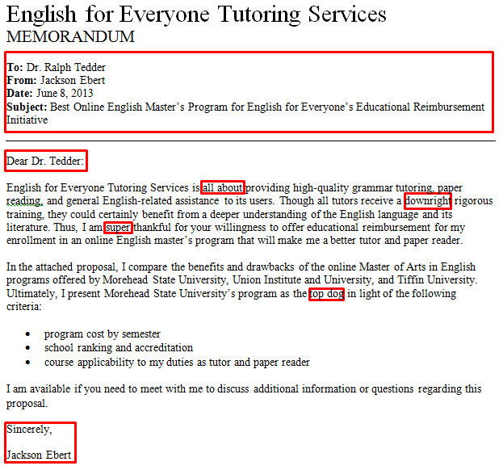
(1) The headings should be capitalized, (2) the information following them should be aligned, (3) the Dr. preceding the recipient’s name should probably be removed, and (4) the subject line should probably be compressed.
The body should not begin with a salutation.
The boxed words in the body of the memo are informal and should be upgraded.
The memo should not end with a complimentary close or a signature block.

Slide 10
The errors have now been corrected.
The complimentary close and signature block have been removed.

Slide 11
Reminders
Do not include a salutation.
Do not use slang or informal language.
When appropriate, use bulleted lists to improve readability.
Do not include a complimentary closing or signature block.

Slide 12
Reference
Bovee, Courtland L., and John V. Thill. Business Communication Today. 10th ed. Boston: Pearson, 2012. Print.

