Slide 1
Typography of Titles in MLA
Created by
John David Brown
Spring 2014
Source: MLA Handbook for Writers of Research Papers, Seventh Edition

Slide 2
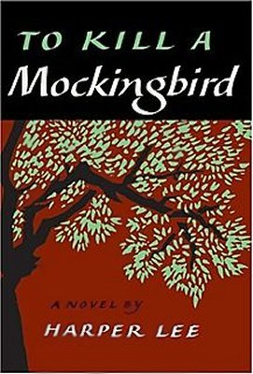
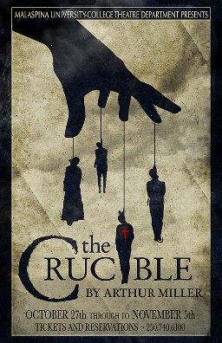
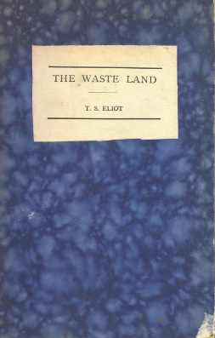
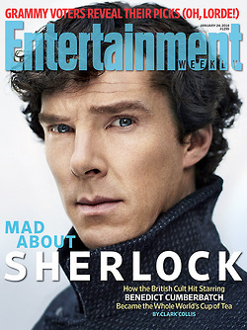
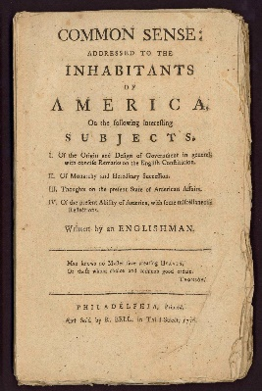
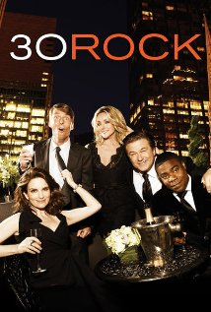
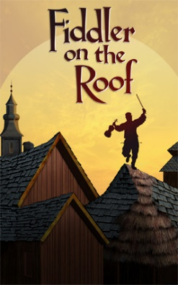
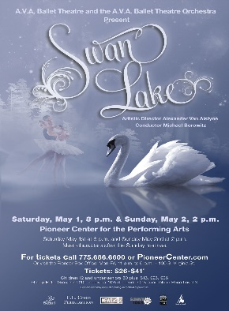
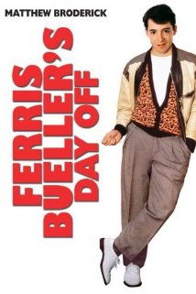
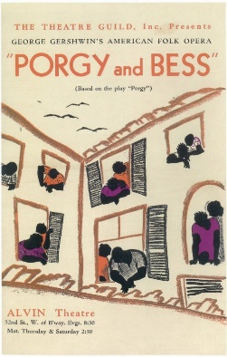
Italicize
MAGAZINE: Entertainment Weekly
JOURNAL: James Joyce Quarterly
WEB SITE: Facebook
ONLINE DATABASE: JSTOR
FILM: Ferris Bueller’s Day Off
TELEVISION SHOW: 30 Rock
BOOK: To Kill a Mockingbird
PLAY: The Crucible
POEM PUBLISHED AS A BOOK: The Waste Land
PAMPHLET: Common Sense
NEWSPAPER: The Pensacola News Journal

Slide 3
Italicize
RADIO BROADCAST: A Prairie Home Companion
MUSIC ALBUM: Goodbye Yellow Brick Road
DANCE PERFORMANCE: Swan Lake
OPERA: Porgy and Bess
LONG MUSICAL COMPOSITION IDENTIFIED BY NAME: Berlioz’s Symphonie fantastique
MUSICAL PLAY: Fiddler on the Roof
PAINTING: Starry Night
SCULPTURE: David
SHIP: USS Alabama (Notice that “USS” is not italicized.)
AIRCRAFT: Air Force One
SPACECRAFT: Apollo 11

Slide 4
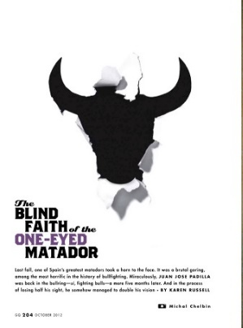
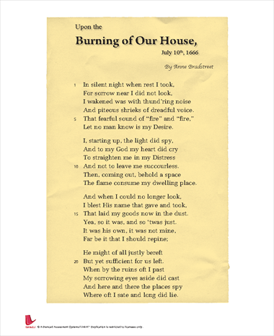
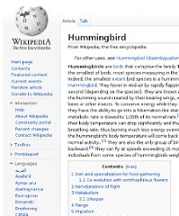
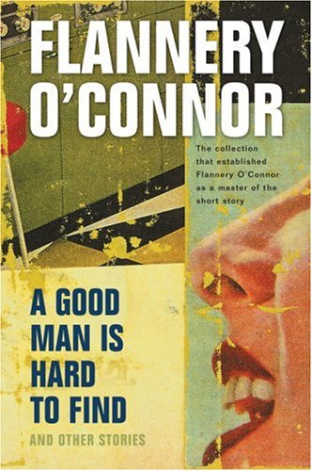
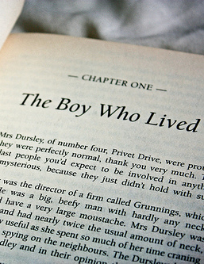
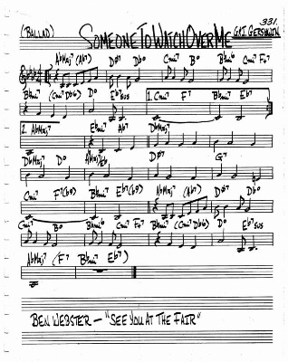
“Quotation Marks”
JOURNAL ARTICLES: “Logical Action in The Catcher in the Rye”
MAGAZINE ARTICLE: “The Blind Faith of the One-Eyed Matador”
ENCYCLOPEDIA ARTICLE: “Hummingbird”
SHORT STORY: “A Good Man Is Hard to Find
POEM: “Upon the Burning of Our House”

Slide 5
“Quotation Marks”
CHAPTER: “The Boy Who Lived”
ESSAY: “Is Everyone Hanging Out Without Me?”
WEBPAGE: “How to Make Chicken Enchiladas”
TV EPISODE: “The Rural Juror”
SONG: “Someone to Watch Over Me”
LECTURE: “Preparing for a Successful Interview”

Slide 6
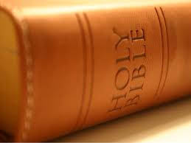
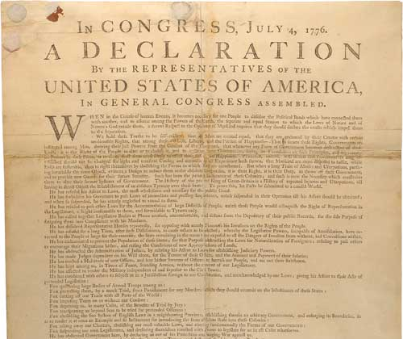
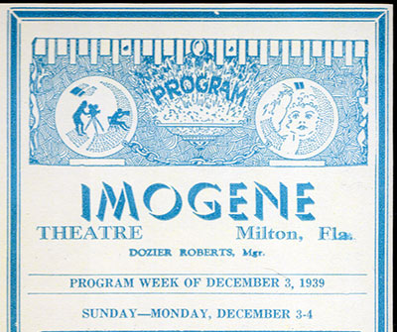
No additional typography
SCRIPTURE: the Bible
LAWS, ACTS, AND POLITICAL DOCUMENTS: the Declaration of Independence
MUSICAL COMPOSITIONS IDENTIFIED BY FORM, NUMBER, AND KEY: Beethoven’s Symphony no. 7 in A, op. 92
SERIES: Chipola College Artist Series
SOCIETIES: Writers’ Guild of America
BUILDINGS AND MONUMENTS: Imogene Theatre
CONFERENCES, SEMINARS, WORKSHOPS, AND COURSES: Early American Literature
WORDS DESIGNATING THE DIVISION OF A WORK: scene 7

