Slide 1
MLA Manuscript Format
Created April 2012

Slide 2
Margins
Leave margins of one inch at the top and bottom and on both sides of the text.
This rule excludes page numbers and should be half of an inch from the margin.

Slide 3
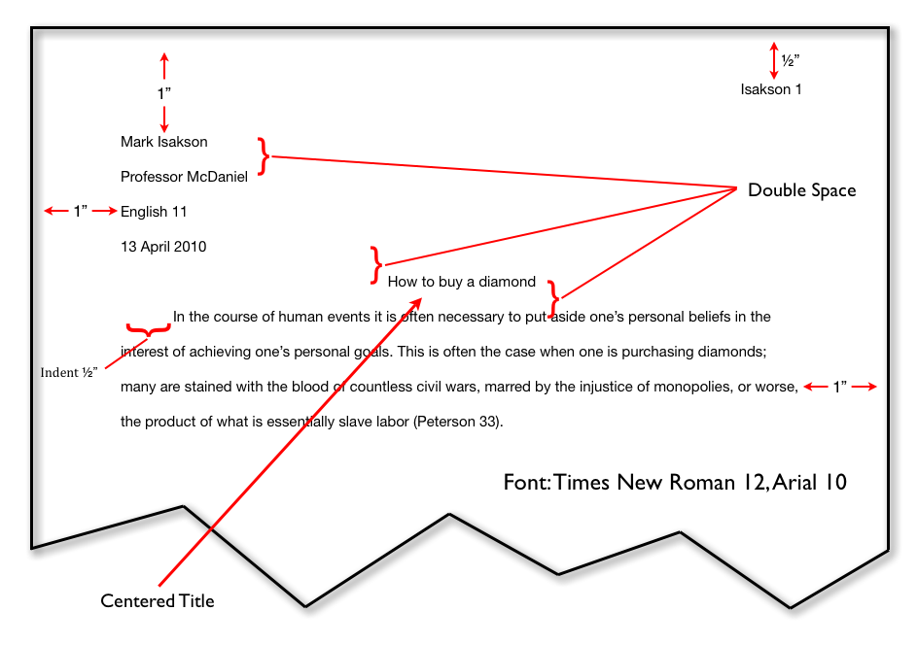
Heading and Title
The student’s name, instructor’s name, course number, and the date should be on the left margin, double-spacing between the lines.
The title should be centered, double-spacing between heading and text.

Slide 4
The Date
. The date that is displayed on the paper is the date that the paper is due, not the day that it is written; in addition, the date is displayed in military style with no commas: 15 July 2009.

Slide 5
Title
Do not do or use the following to the title:
Italicize
Underline
Put in quotation marks
Put a period after title
Boldface
All capital letters
Italicize and use quotation marks only with the words that you would italicize in the text.

Slide 6
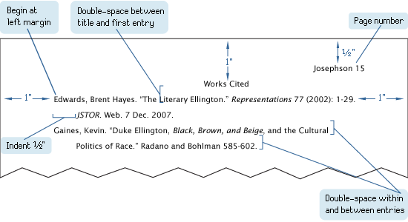
Page Numbers
Number all pages consecutively in the upper right-hand corner, one-half inch from the top and flush with the right margin.
Type your last name before the page number.
Make sure to use the same font and size as the rest of your paper.
Do not use the abbreviation p. before a page number or add a period, a hyphen, or any other mark or symbol.

Slide 7
Tables and Illustrations
A table is labeled Table, given an Arabic numeral, and titled.
Type both label and title flush left on separate lines above the table, and capitalize them as titles.
Give the source of the table and any notes immediately below the table in a caption.
Designate notes to the table with lowercase letters rather than with numerals.
Double-space throughout.
Any other type of illustrative visual material—a photograph, map, line drawing, graph, or chart—should be labeled Figure (abbreviated Fig.), assigned an Arabic numeral, and given a caption.
A label and caption ordinarily appear directly below the illustration and have the same one-inch margins as the text of the paper.

Slide 8
Information came from MLA Handbook for Writers of Research Papers

