Slide 1
Who are the Jews of India?
The following slides were prepared for lectures at a Jewish temple in Florida and in Pennsylvania.
M. Lal Goel, uwf.edu/lgoel

Slide 2
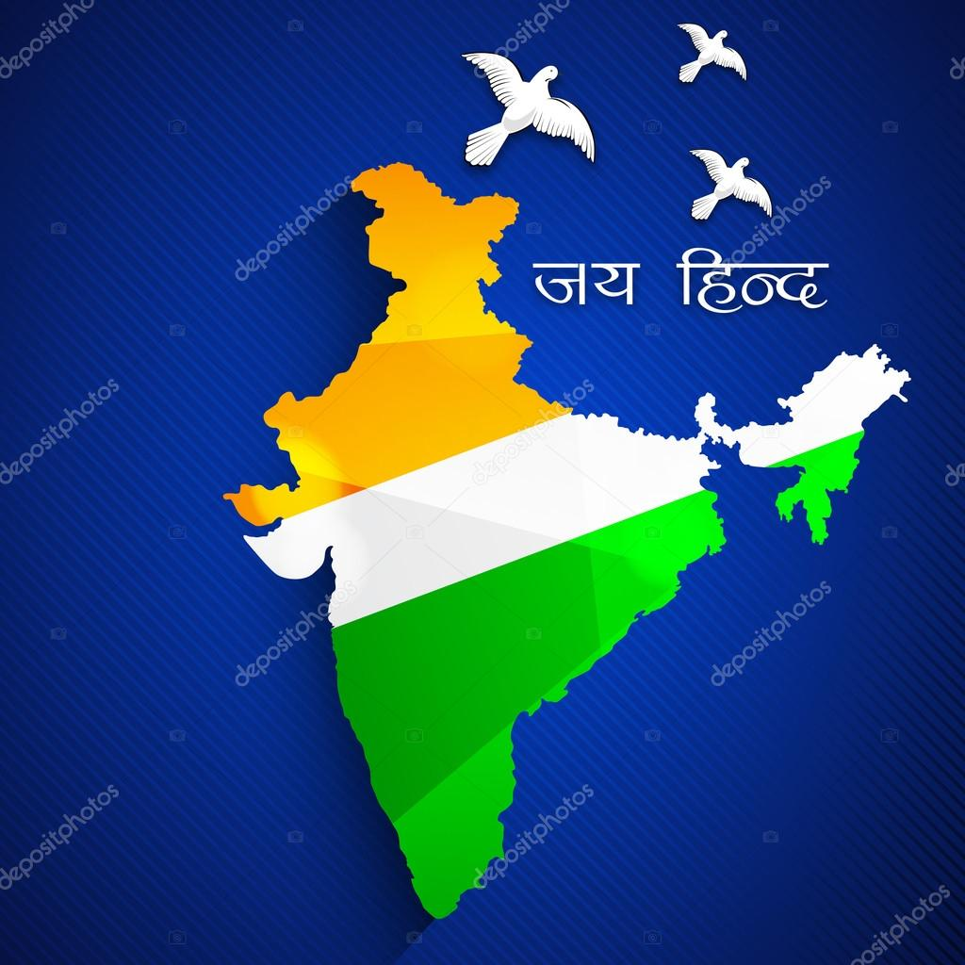
INDIA

Slide 3
Jews are Global
Jews are not Western, but GLOBAL.
Jewish history does not begin and end with Europe. It is also Asian, both in origin and destiny.
The land of Israel is located in Asia.

Slide 4
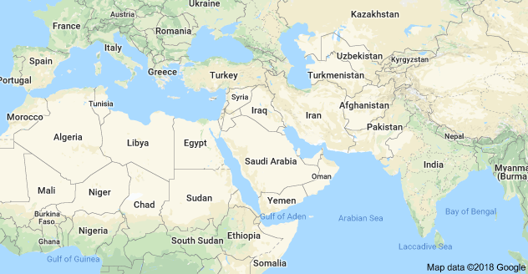
Map of India and the Middle East

Slide 5
Jews of India
Indian Jews are small in number, a mere 50,000 to 80,000.
Jews have lived in India for some 2000 years.
They have been an integral part of the Indian landscape.
Their numbers are small, but contributions are large.
They are “the salt in India’s pot.”

Slide 6
India’s 3 Jewish communities
1. Cochin Jews
2. Bene Israel of Bombay and vicinity
3. the Baghdadi Jews of Bombay and Calcutta
See the attached map.

Slide 7
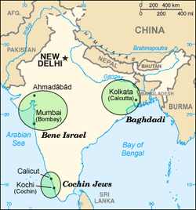
India’s Three Jewish Communities

Slide 8
Cochin Jews in the State of Kerala
They are the oldest of the three Jewish communities in India.
They entered India when the Romans destroyed the Jerusalem temple in 70 AD. Some Sephardic Jews also entered India after 1492, when Spain expelled them.
The Hindu Maharaja Chera Verma welcomed the Jews. The Maharaja presented the Jews with Copper Plates, thus establishing their status.
An image of the Descendant of the Maharaja is attached.

Slide 9
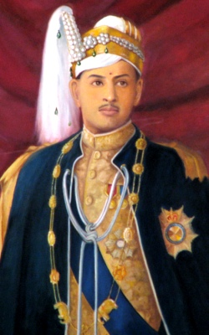
Descendant of Maharaja Chera Verma

Slide 10
Cochin Jews
They were full members of the South Indian society.
They were not persecuted or discriminated against.
A Cochin Jew: “ The word anti-Semitism does not exist in the Hindu dictionary.”

Slide 11
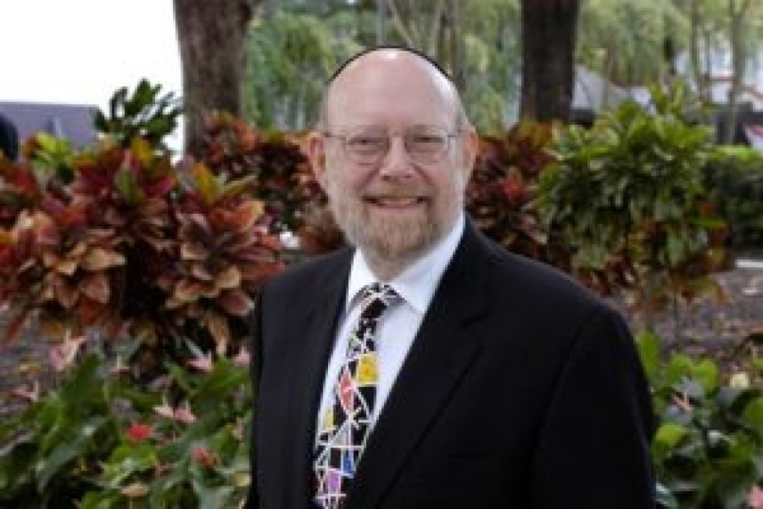
Dr. Nathan Katz, FIU, writes:
“The Indian chapter is one of the happiest of the Jewish Diaspora.”
“Indian Jews lived as all Jews should have been allowed to live: free, proud, observant, creative and prosperous, self-realized, full contributors to the host community.”

Slide 12
Cochin Jews
The Cochin Jews were authorized to collect taxes.
They could ride elephants in a procession, a royal privilege.
They built a Synagogue in 1568, the oldest in the British Commonwealth.
The Cochin temple celebrated its 400th year anniversary in 1968.
PM Indira Gandhi attended the ceremony in 1968.

Slide 13
PM Indira Gandhi

Slide 14
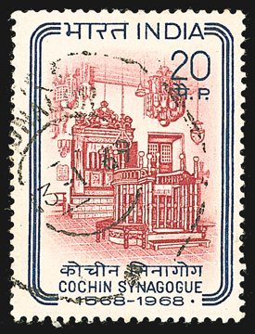
The 400th year Anniversary Stamp, 1568-1968. Cochin synagogue

Slide 15
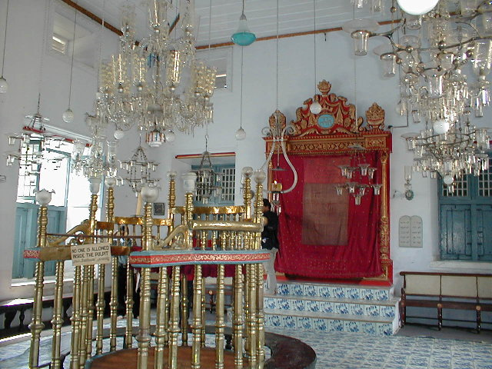
Cochin Temple

Slide 16
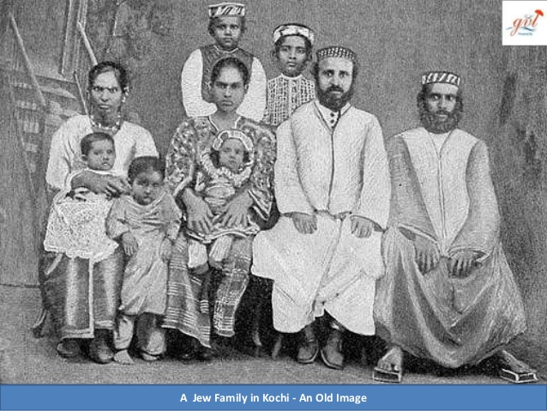

Slide 17
Jew Street in Cochin (now called Kochi).

Slide 18
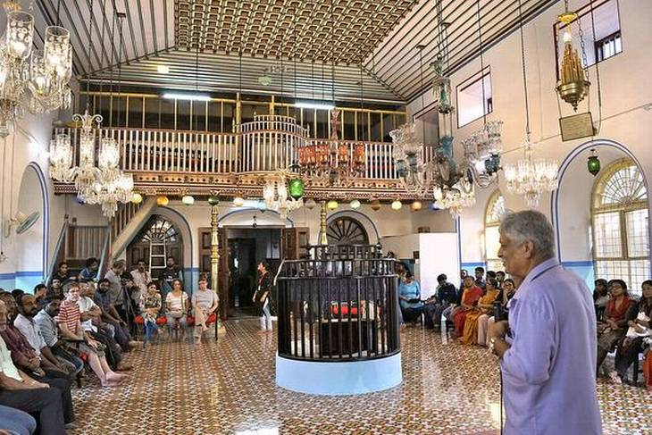
Cochine Temple

Slide 19
Bene Israel of Bombay
Settled around Bombay and Poona. Known as Shanivar Telis, i.e., oil pressures, who would not work on Saturdays.
They trace their presence in India as the result of a ship-wreck, some 2,000 years ago. Only 7 families survived the shipwreck.
They are poorer of the three Jewish communities in India.
They are mixed with Indian blood and are brownish in color.
They had difficulty in being accepted as authentic Jews.

Slide 20
India’s Three Jewish Communities

Slide 21
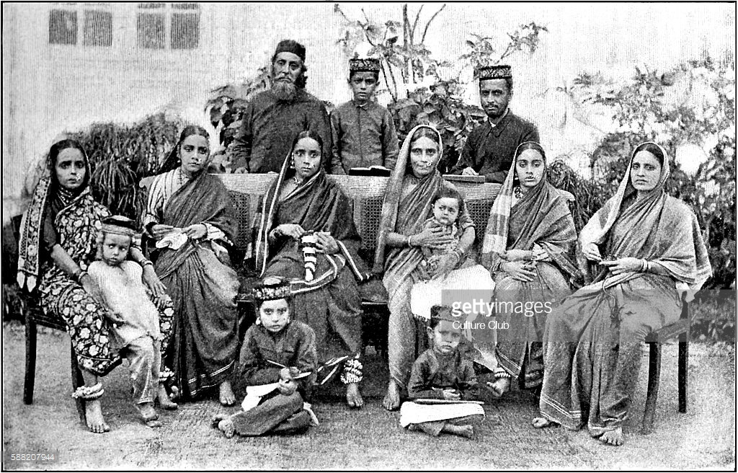
Bene Israel—an Old Image

Slide 22
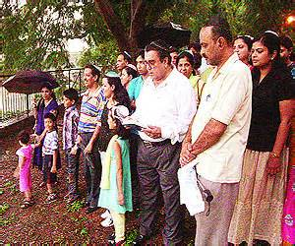
Bene Israel of Bombay, about 1960
Bene Israel--a New Image, Bombay

Slide 23
Baghdadi Jews
They entered India 250 years ago in 1700s after being expelled by the Ottoman Turks who ruled Baghdad.
Of the three Jewish groups in India, they are the richest. They ran businesses in Bombay, Calcutta, Hong Kong, Shanghai, & Singapore
Unfortunately, the Baghdadi Jews discriminated against the poorer Bene Israel. The two groups worshipped in separate temples.

Slide 24
David Sassoon
David Sassoon 1792-1864, leader of Baghdadi Jews

Slide 25
David or Daud Sassoon (1792-1864)
He landed in India in 1833, after being expelled from Baghdad. He managed to bring part of his family fortune and set up a shop in Bombay.
Later, he entered the very lucrative Opium Trade from India to China. He earned high profit.
In 1860s during the American Civil War, he exported cottons from India to the Lankashire mills in England.
David Sassoon became one of the richest persons in India in the 19th C.

Slide 26
David Sassoon (cont.)
David Sassoon did not speak English. He dressed in native costume and wore a turban in the Middle-Eastern fashion.
But he encouraged his sons to learn English, and to adopt English manners.
His son Albert moved to England, became a baronet, and was married into the Rothschilds of Europe.
David Sassoon was charitable: He built Synagogues, a hospital and a library.
He was conscious of his role as a leader of the Jewish community.

Slide 27
David Sassoon with his 3 Sons

Slide 28
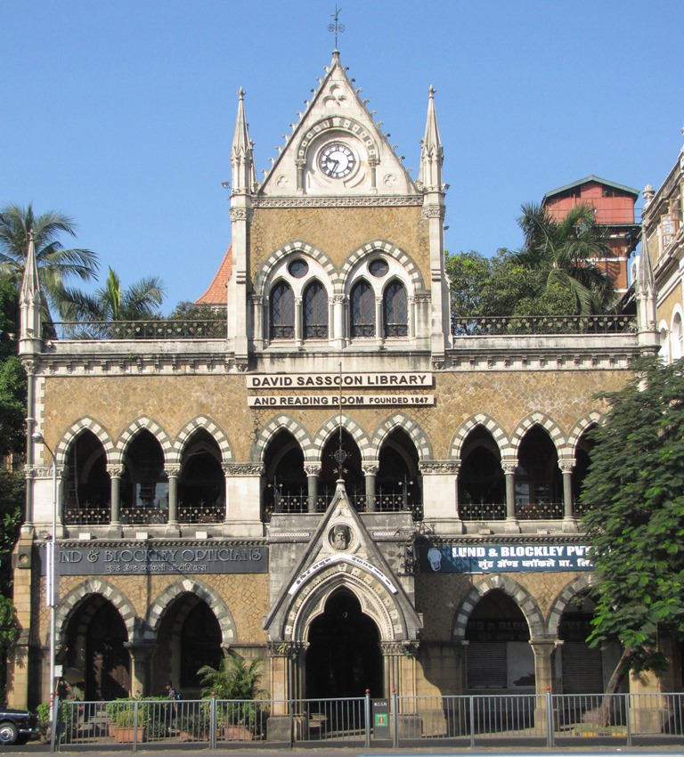
David Sassoon Library, Bombay

Slide 29
Synagogue in Poona
Jewish Temple in the City of Poona
South of Bombay

Slide 30
Why Jews flourished in India?
For centuries, India has been a multi-cultural, multi-ethnic, multi-religious society.
Dozens of different ethnic, religious, and cultural groups have lived in India.

Slide 31
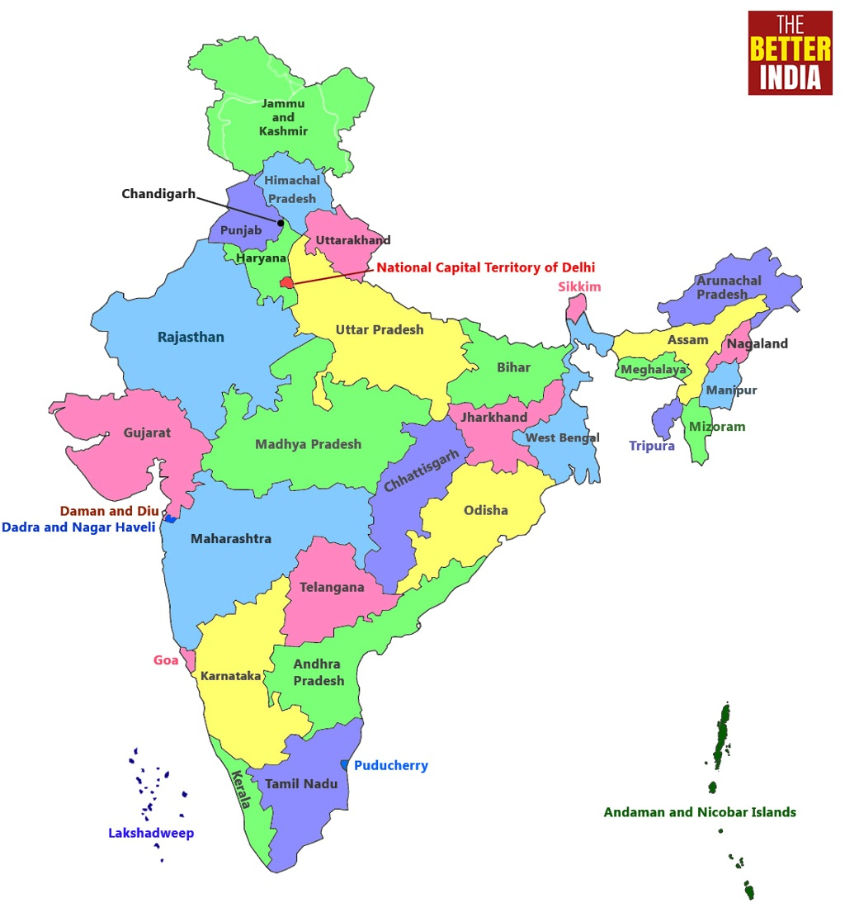
States in India

Slide 32
In pluralistic India, persecuted minorities from outside could always find a home. Several minority groups who found a home in India include:
Jews
Parsees , i.e. Zoroastrians from Persia who fled to India to escape Islamic invasions
Syrian Christians, who entered India to escape Islamic expansion.
Bahaiis from the Middle East. The Bahaiis are settled in many countries, including the US and UK. The largest number of Bahaiis live in India.
Tibetans, who fled Chinese control of Tibet, including the Dalai Lama.
Bangladeshis, who face terrorist attacks in their homeland.

Slide 33
Kaifeng Jews in China
The Kaifeng Jews are members of a small Jewish community in Kaifeng, in Northeastern China.
They were assimilated into Chinese society while preserving some Jewish traditions, while Indian Jews kept their traditions.
Their origin and time of arrival in Kaifeng are a matter of debate among experts.
They do not look different from Han Chinese.
Visit: Who are Jews of China and Japan on this site.

Slide 34
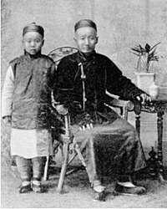
Kaifeng Jews

Slide 35
Indian Jewish community survived in contrast to Jews in China
Jews survived in India as a community because India celebrated ethnic and cultural pluralism thru history, much in fashion today.

Slide 36
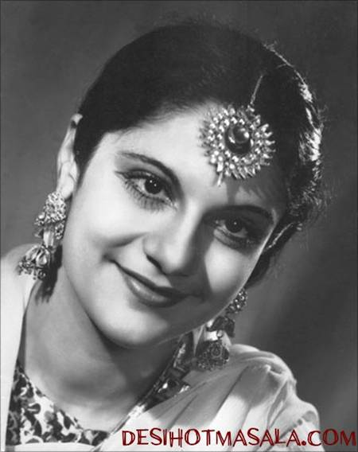
Miss Pramila, a Jewish girl, was the First Miss India, 1947.

Slide 37
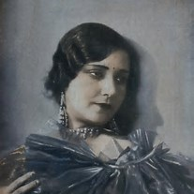
Miss Sulochana –a leading lady in Indian films, 1930s-1940s

Slide 38
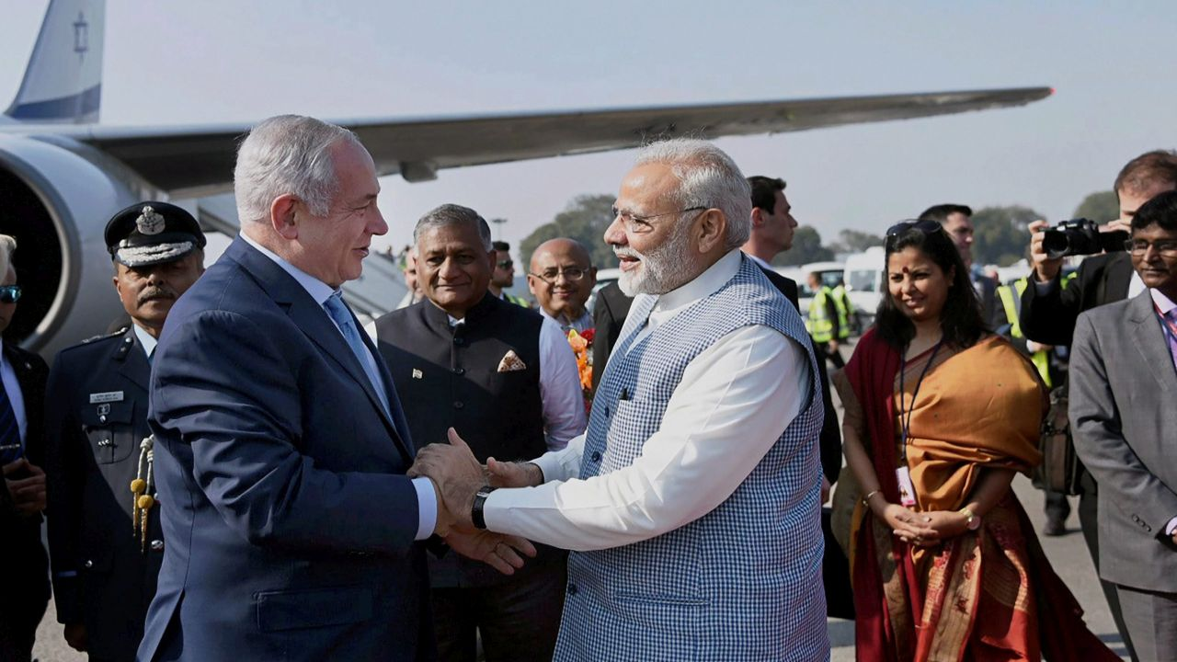
Prime Minister Narendra Modi visits Israel, 2017

Slide 39
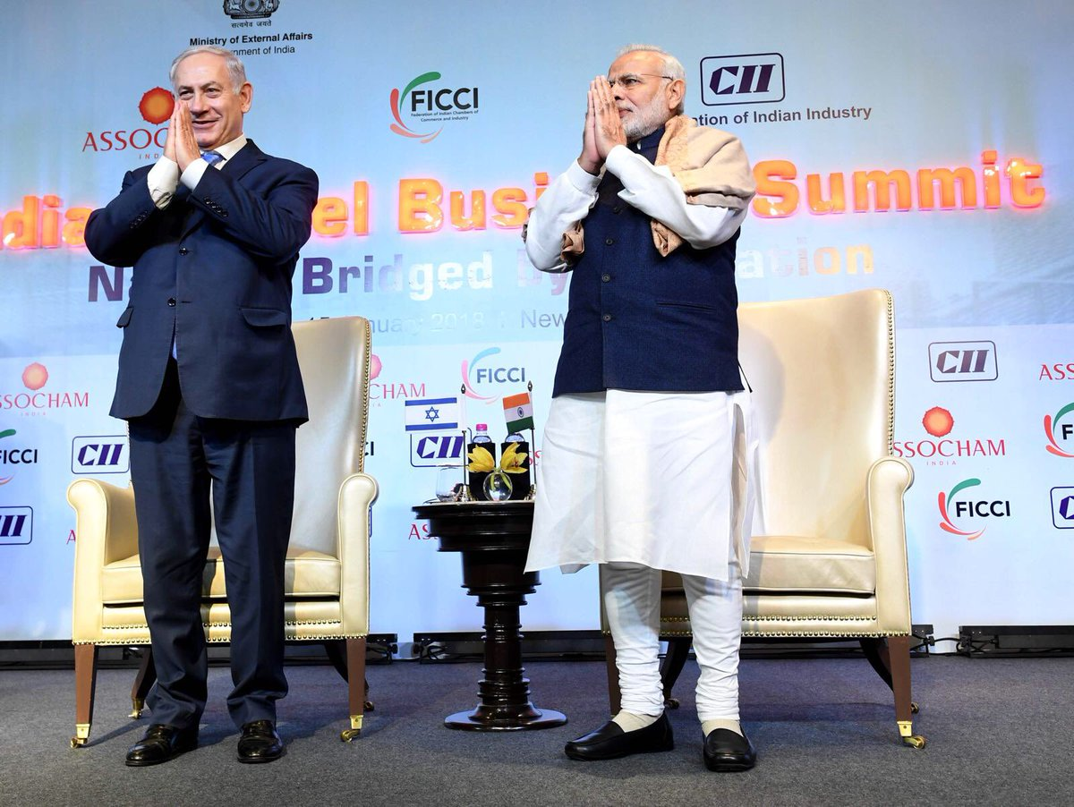

Slide 40
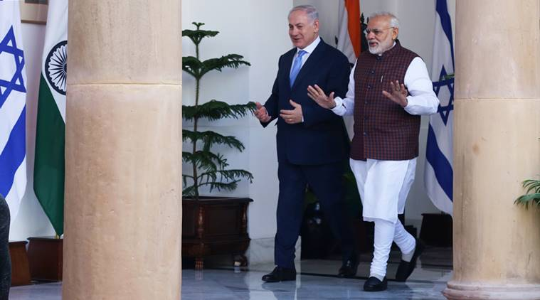

Slide 41
Why is PM Modi hugging little 12 year old Moshe in the next picture?
The infant child survived an Islamic terrorist attack on the Chabad House in Mumbai, 2008.

Slide 42
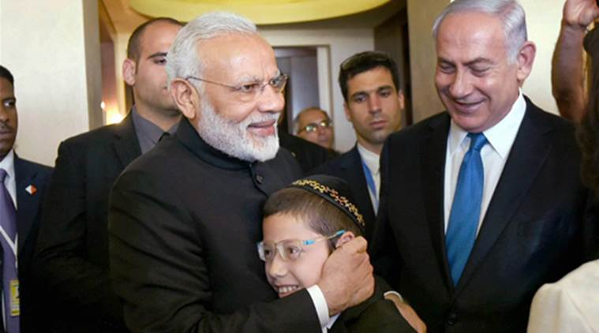

Slide 43
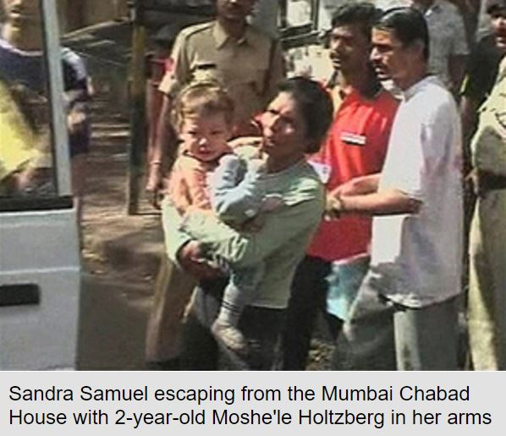
Islamic Terrorists attack Chabad House in Bombay

Slide 44
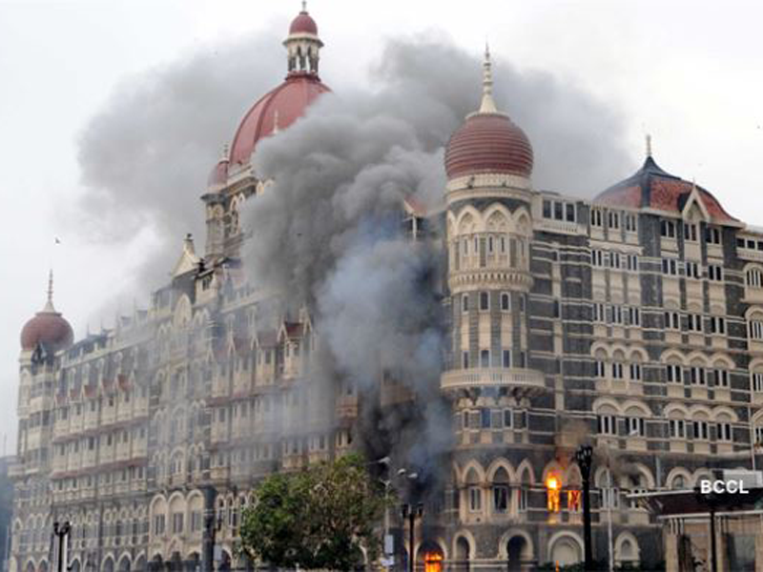
The Taj Mahal Hotel burns, 2008

Slide 45
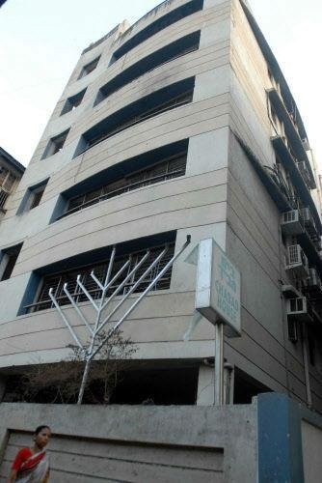
The Chabad House
Bombay, damaged during
The attack

Slide 46
Emily Wax of Washington Post spent time in India

Slide 47
Emily Wax writes:
“Jews flourished in India for centuries -- from biblical times, some scholars say. The country also gave safe haven to Jews during World War II.” Small but active Jewish communities remain in Mumbai, including the so-called Baghdadi Jews.
But in Cochin, there is concern that Jew Town soon will be little more than a quirky tourist destination. "We are kosher, but also Indian," said an older Jewish woman, adding that she uses chapati, an Indian flatbread, rather than the braided challah bread of European Jews.

Slide 48
Cont.
The Jewish community here eats no beef, out of respect for the Hindu prohibition on eating cow meat. In Cochin, shoes are taken off before entering the main prayer room, as in Hindu temples, and flowers are used as a part of prayer. "After some years the story of the Jews of Cochin may come to an end," reads the small book handed out to visitors for 10 rupees, or about 20 cents.
"If this happens, history can record that their departure was not motivated by intolerance or discrimination by India."

Slide 49
Most Jews return to Israel
Some 80,000 Jews with Indian roots now live in Israel, 1.5 %.
In India, they were known as Jews or Yehudis. In Israel, they are called Indian.
They are Jewish in faith but Indian in culture. You may call them exotic.
They prefer fish curry and rice, rather than steak and potatoes.

Slide 50
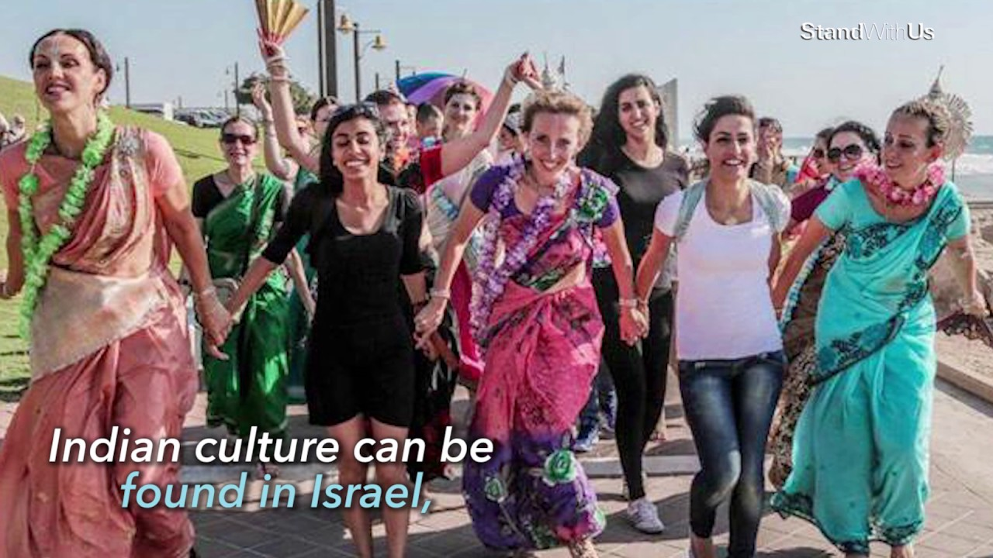

Slide 51
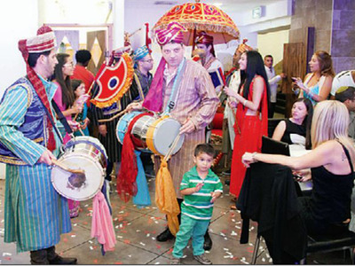
Indian Culture can be found in Israel

Slide 52
King Solomon’s Wisdom has an earlier similar story in India

Slide 54
Jewish Population—top 10 Jewish Data Bank Estimates, 2017
Israel | 6 to 7 million
United States | 6.2 million
France | 478,000
Canada | 380,000
United Kingdom | 290,000
Russia | 190,000
Argentina | 181,500
Germany | 118,000
Australia | 112,500
Brazil | 95,200

Slide 55
Thank you Ladies and Gentlemen.

